Slide 1
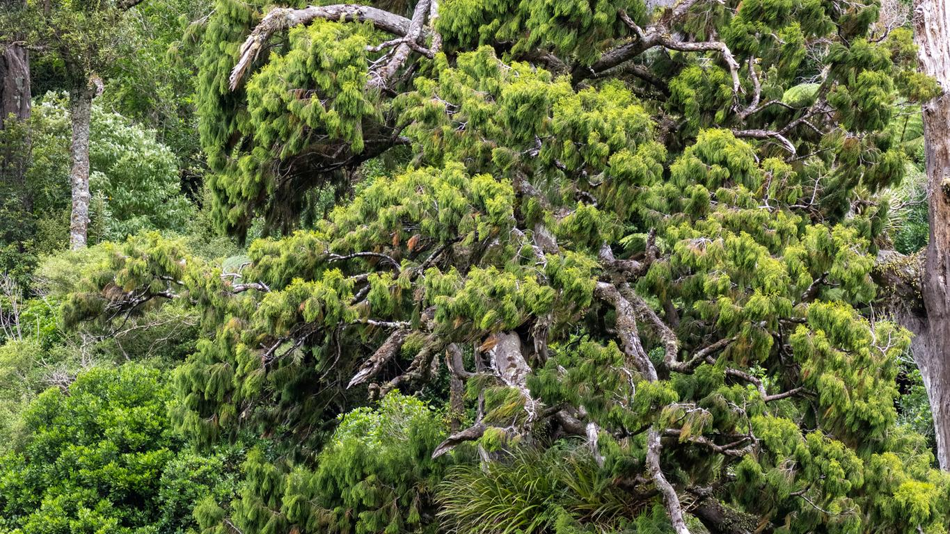
Lūdente linguā
Language Use and Performance in Zoological Nomenclature
Richard Littauer - http://richard.social
Rimu https://www.inaturalist.org/observations/198921399

Slide 2
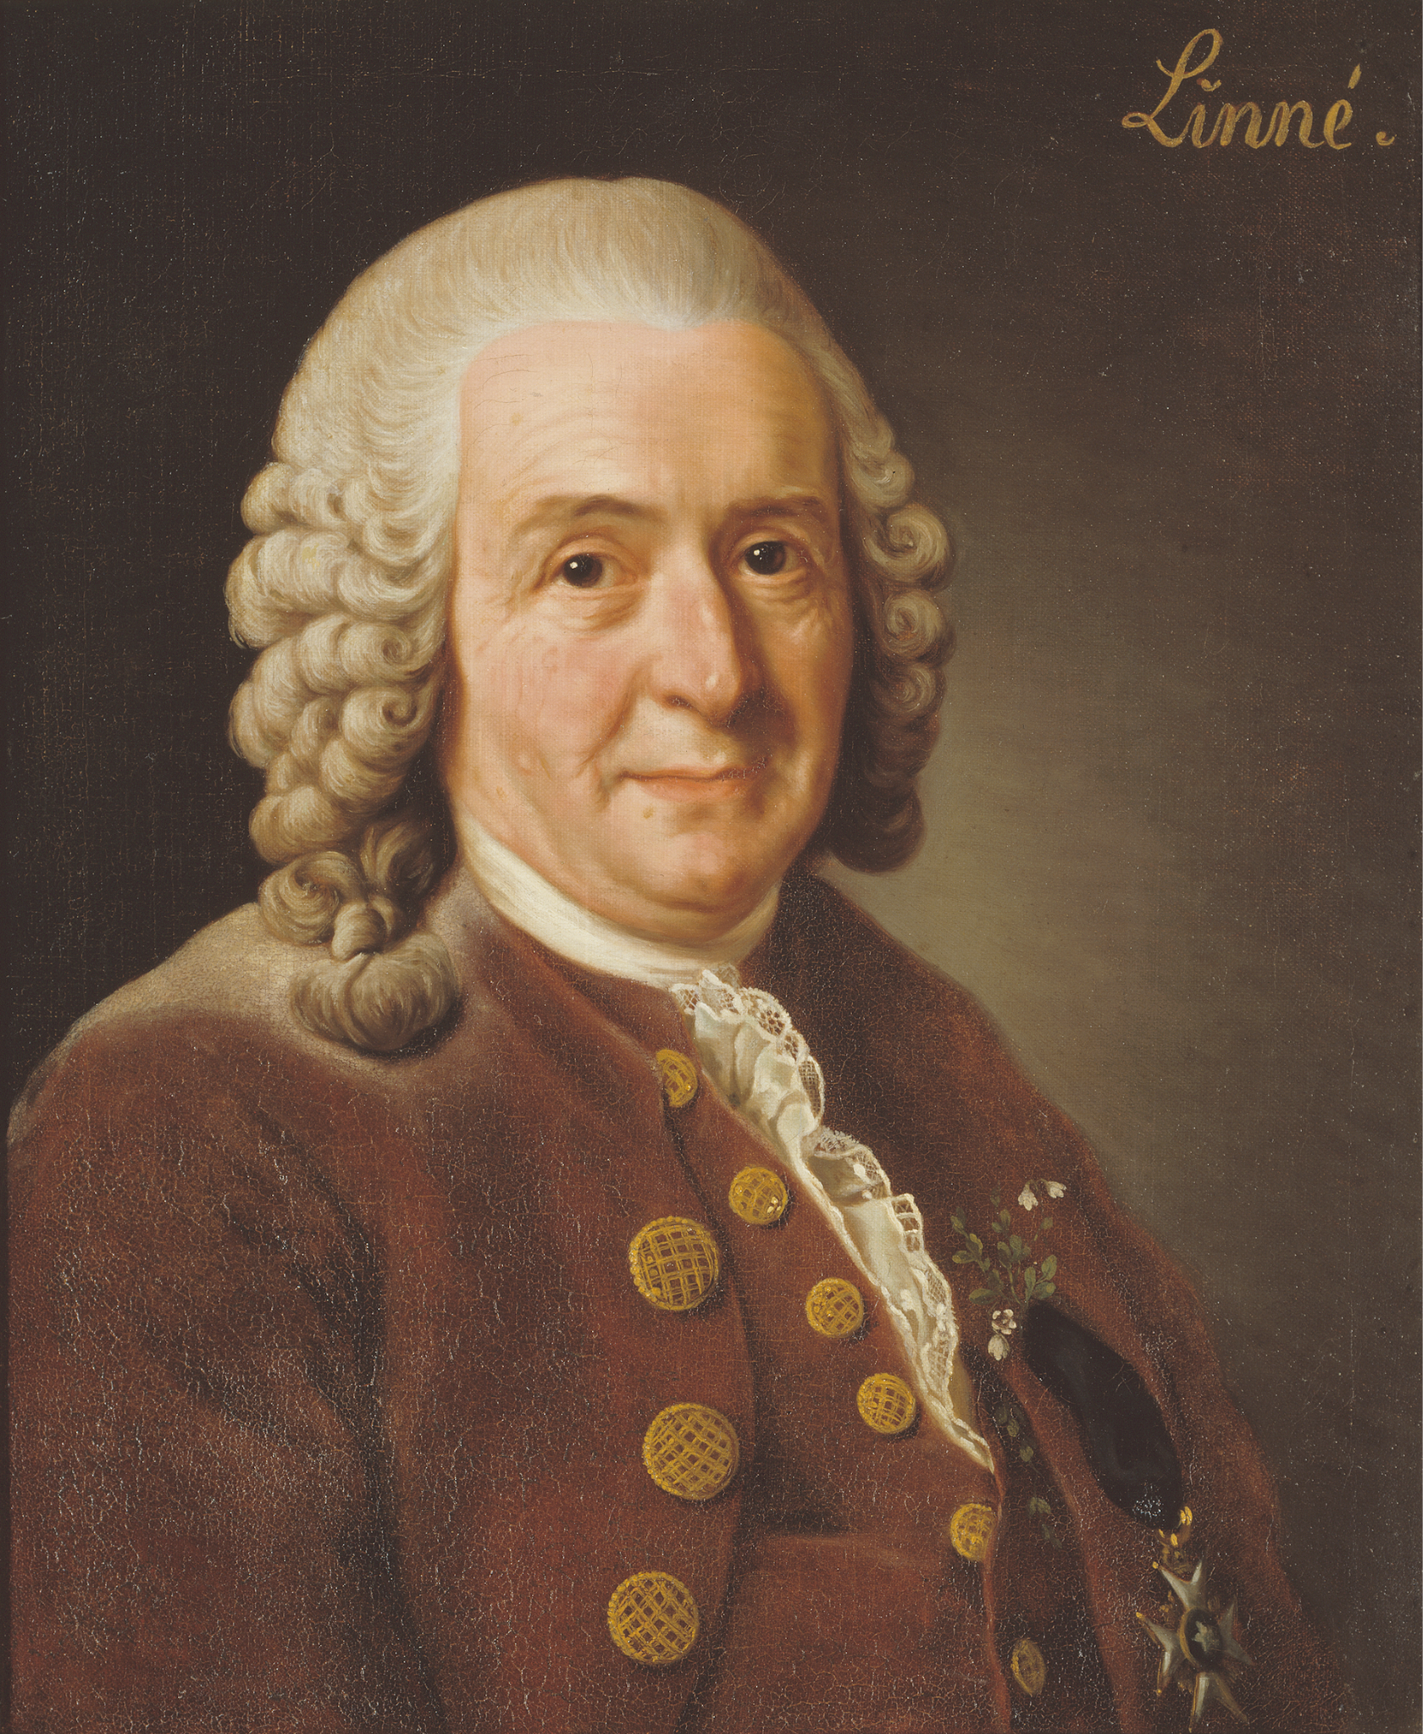
Linnaeus
Abstract
Swedish
1707-1778
The "father of modern taxonomy"
Published Systema Naturæ in 1738
"Linnaeus was in reality a poet who happened to become a naturalist." ~ Strindberg
Wikipedia, Public Domain

Slide 3
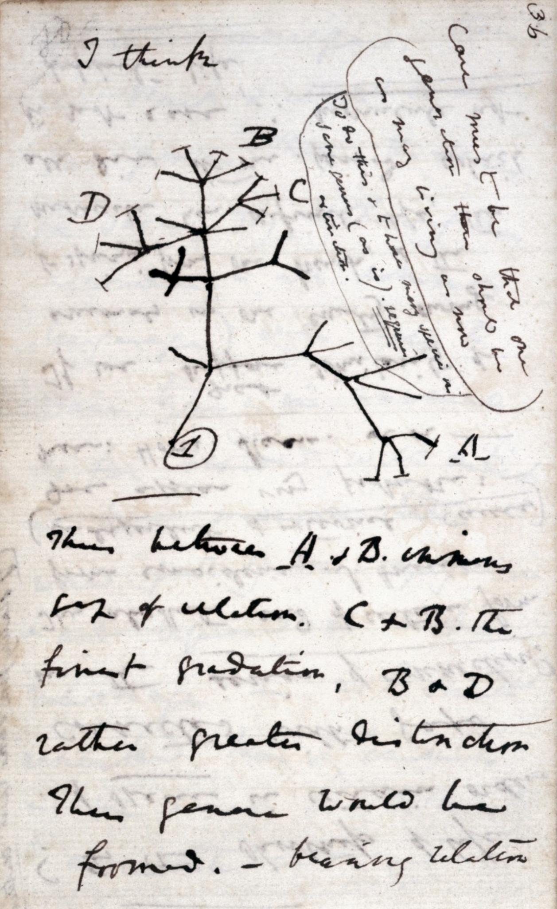
Taxonomy
Abstract
Figuring out how life is related
Naming those life forms.
Public Domain

Slide 4
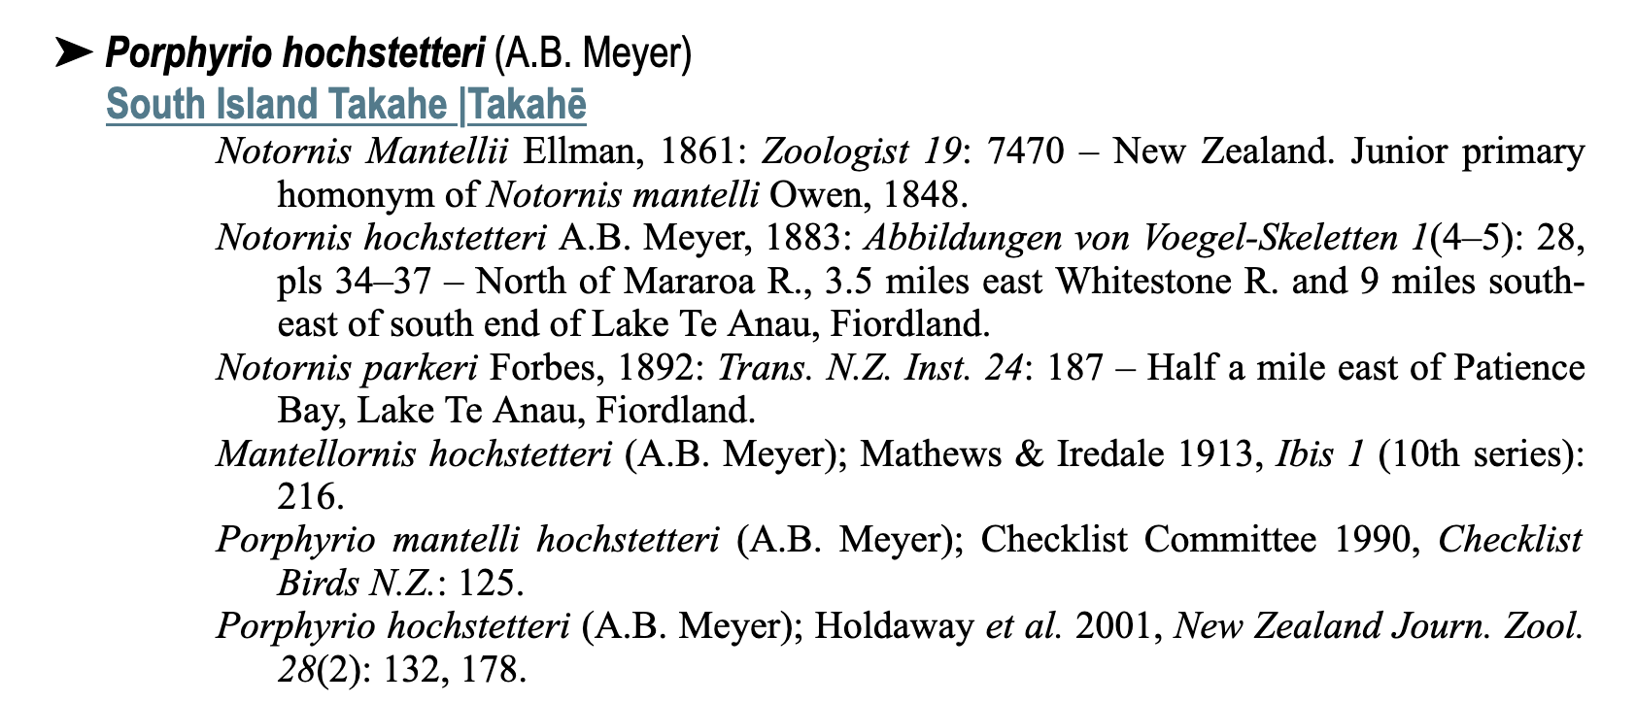
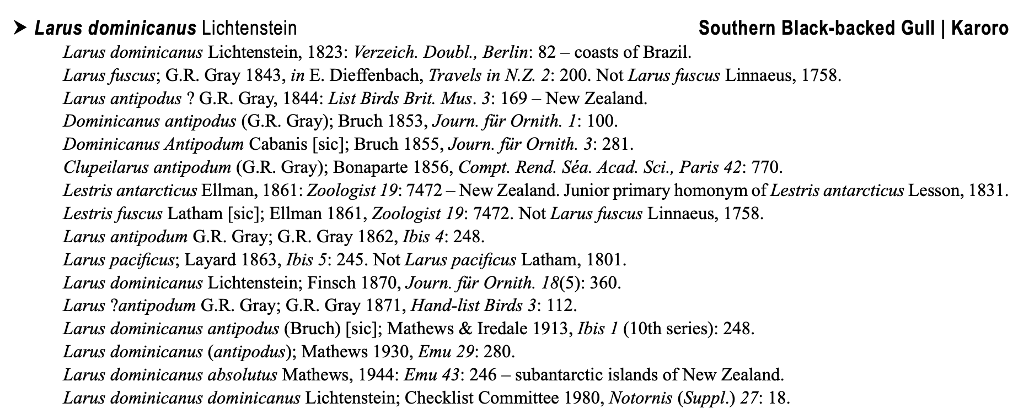

Taxonomy
"The aim of this sixth checklist of New Zealand birds, like its predecessors, is to provide information on the nomenclature, taxonomy, classification, distribution (current, historical, and fossil) and status of the birds of the New Zealand region."
https://www.birdsnz.org.nz/society-publications/checklist/

Slide 5
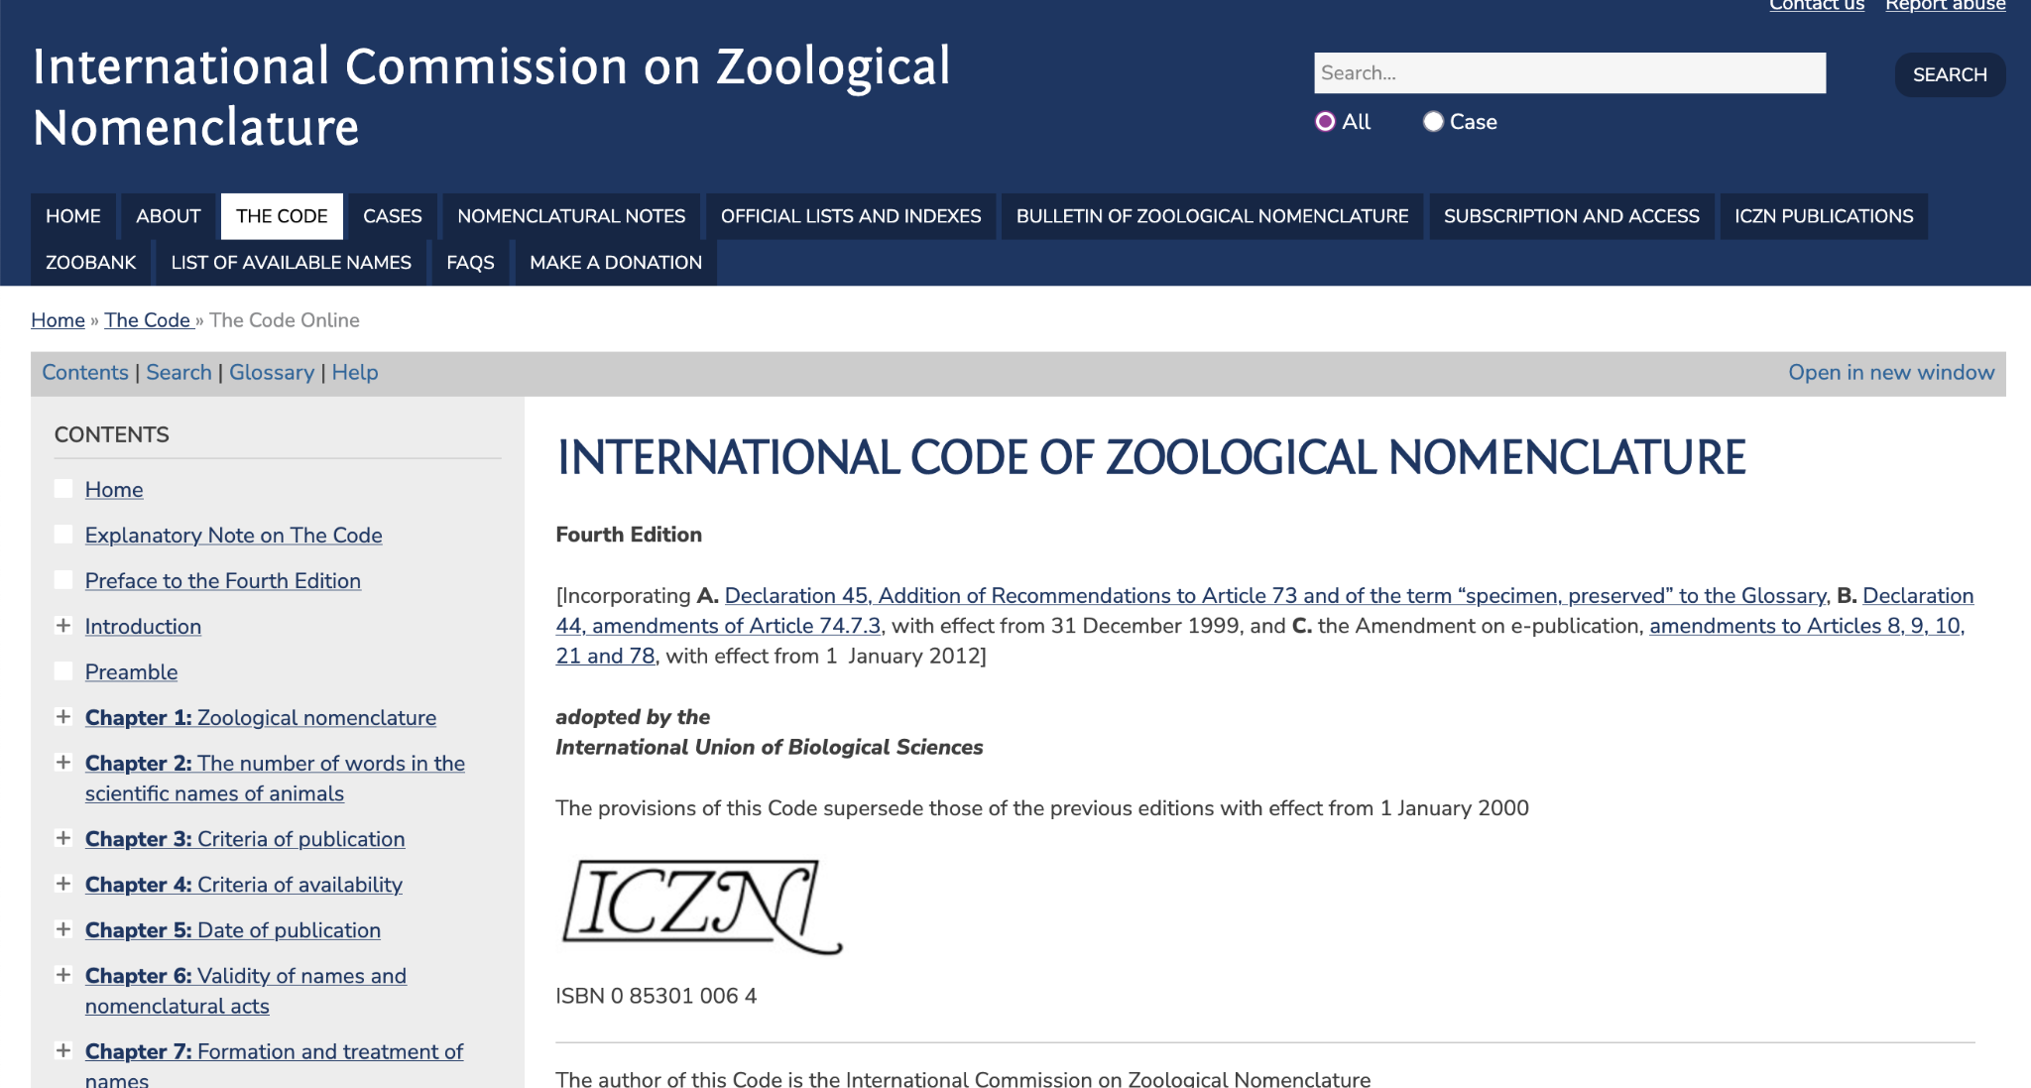

Slide 6
"The Code":
French and English
90 Articles
Glossary
Examples (which don't count)

Slide 7
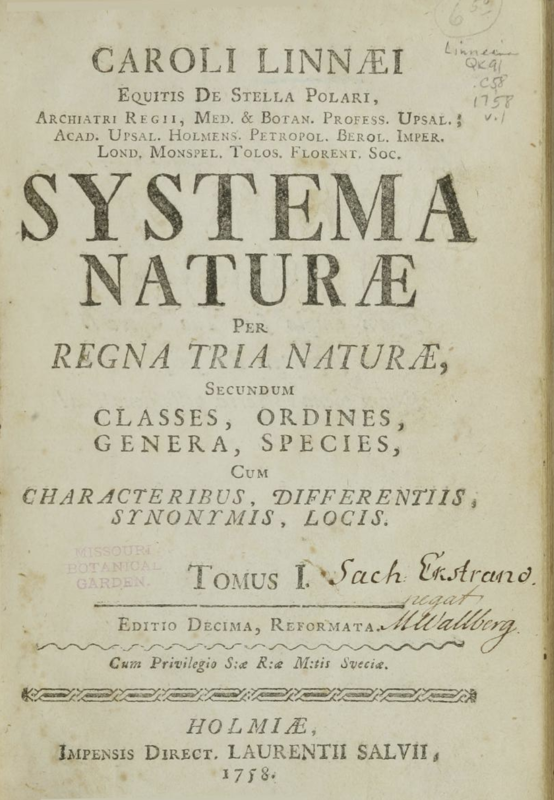
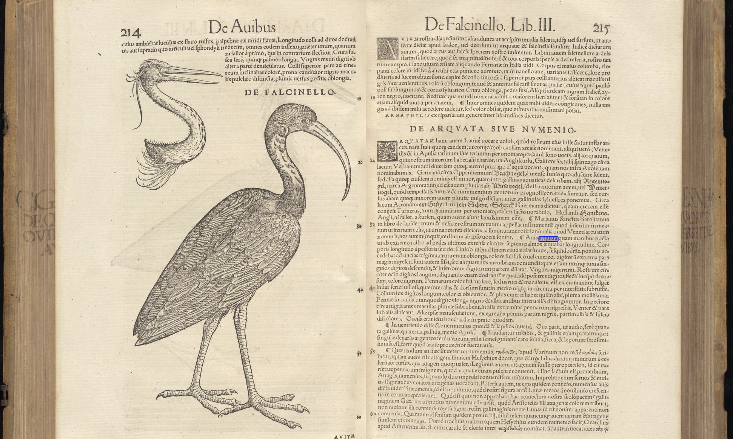
Article 3: The beginning
Starts with Linnaeus 1758, on Jan. 1.
Simultaneously the beginning of the use of the Code, and also of the first valid names
Linnaeus https://www.biodiversitylibrary.org/page/727037#page/3/mode/1up Gessner: https://archive.org/details/gri_33125010867691/page/214/mode/2up?q=Arquata

Slide 8
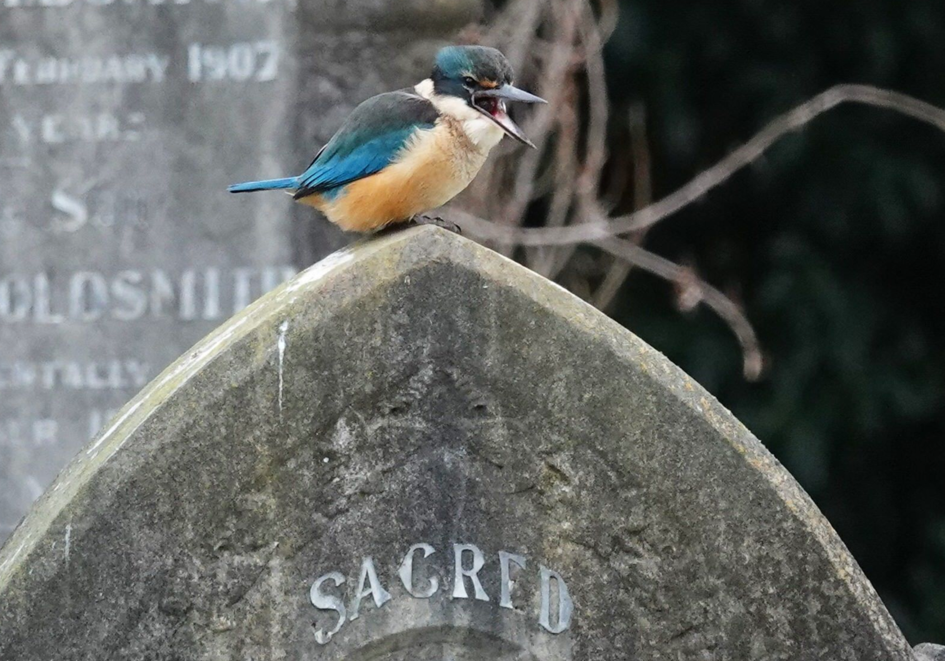
Article 8.2 Disclamation
"A work that contains a statement to the effect that it is not issued for public and permanent scientific record, or for purposes of zoological nomenclature, is not published within the meaning of the Code."
This presentation is so stated.
© Jacqui Geux https://www.inaturalist.org/observations/28103314

Slide 9
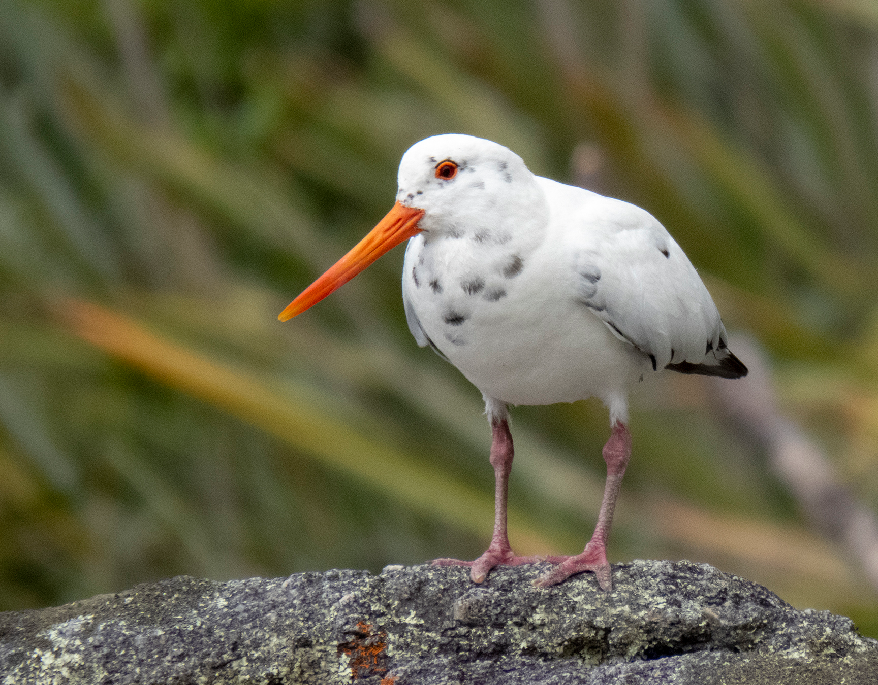
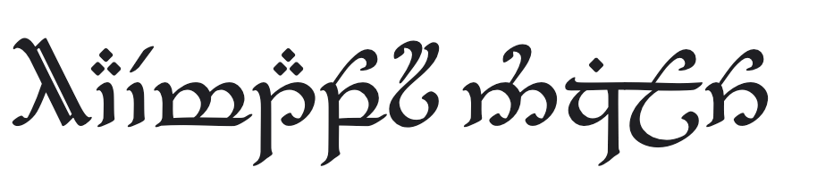
Article 11.2 Latin alphabet
Haematopus unicolor
And not:
© Sebastian Doak https://www.inaturalist.org/photos/107051293

Slide 10
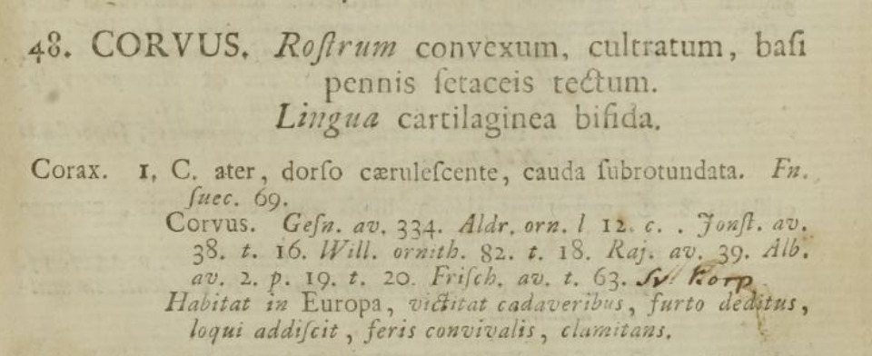
Article 11.3 Derivation
Names don't have to be Latin names.
Cf. Manu antiquus Marples, 1946, or Corvus corax Linnaeus, 1738
Systema Naturæ https://www.biodiversitylibrary.org/page/727037
© Sebastian Doak https://www.inaturalist.org/photos/107051293

Slide 11
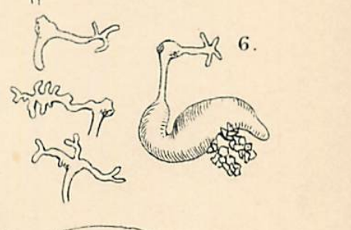
Article 11.9 Species names
Can be:
an adjective in the nominative singular
a noun in the nominative singular
a noun in the genitive case, or:
"11.9.1.4. an adjective used as a substantive in the genitive case and derived from the specific name of an organism with which the animal in question is associated (as in Lernaeocera lusci, a copepod parasitic on Trisopterus luscus)."
Bassett-Smith, P.W. (1896). Notes on the parasitic Copepoda of fish obtained at Plymouth, with descriptions of new species. Annals and Magazine of Natural History (6)18:8-16, pls. 3-6. (vii-1896) https://www.marinespecies.org/aphia.php?p=sourcedetails&id=71842
© Sebastian Doak https://www.inaturalist.org/photos/107051293

Slide 12
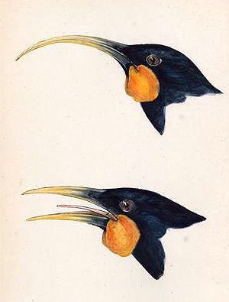
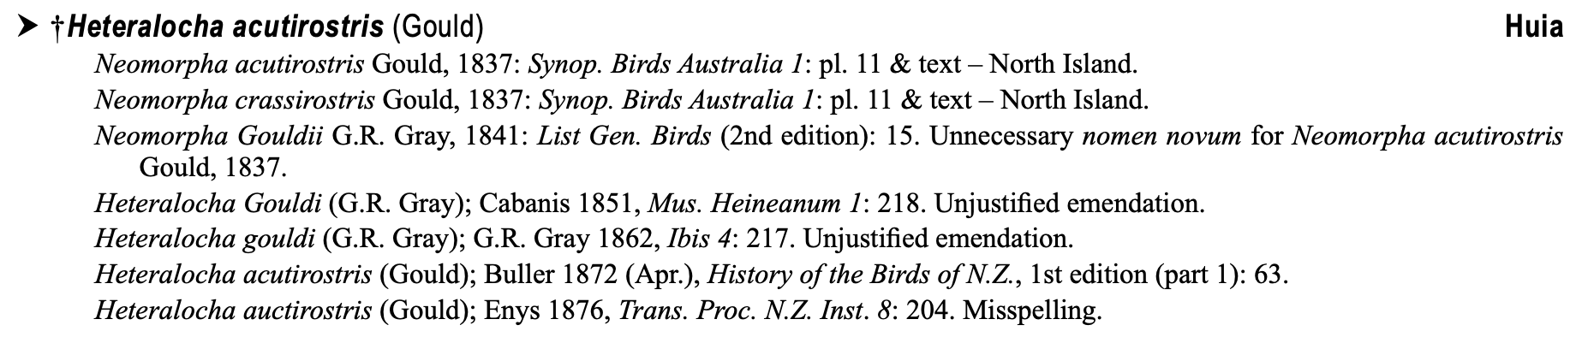
Article 23 Principle of priority
First means first.
Gould, public domain
© Sebastian Doak https://www.inaturalist.org/photos/107051293

Slide 13
Article 24 First Reviser
Many names – Bruce & McAllan (1990)
Calidris melanotos v. maculata Vieillot, 1819 – Wetmore
By me:
Larus dominicanus antipodum v. antipodus Bruch, 1853
Branta v. Brandae Scopoli, 1769
Mohoua, Mohouas, Mohoua-houa Lesson, 183x?
© Sebastian Doak https://www.inaturalist.org/photos/107051293

Slide 14
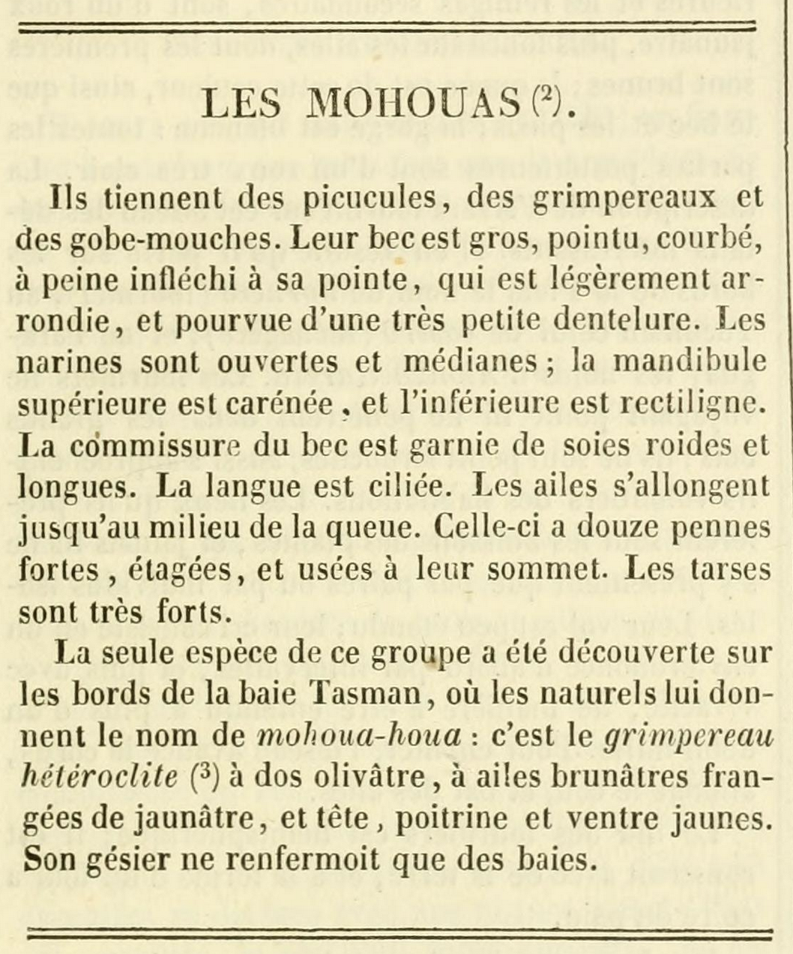
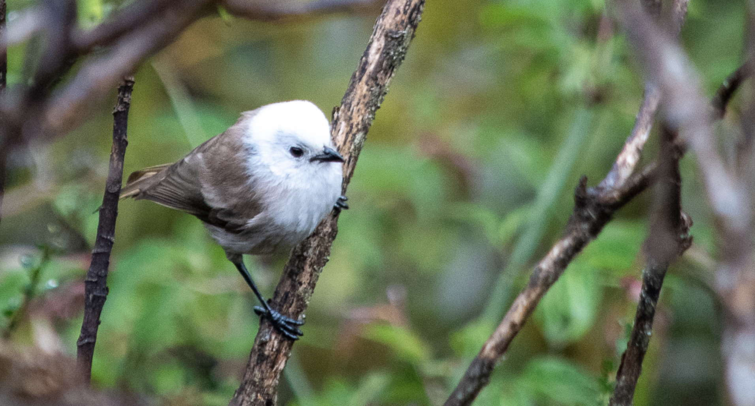
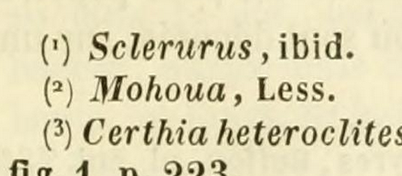
Lesson 1837 (?): Oeuvres completes de Buffon, 9 p. 139

Slide 15
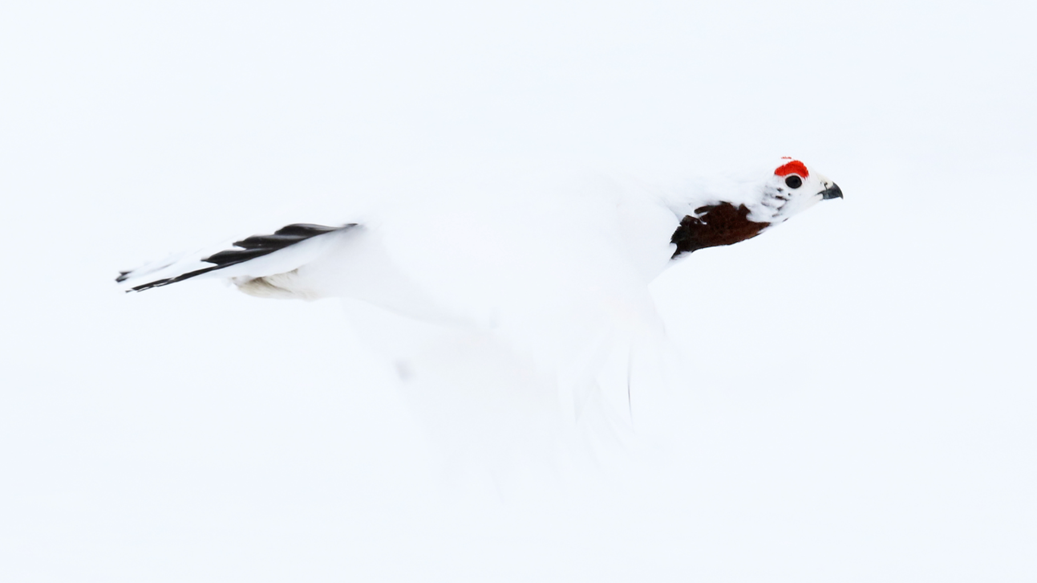
Article 26. Assumption of Greek or Latin
Badly transliterated:
Athene, Gerygone, Eudynamys, Aegotheles, Gymnorhina
Latin or Greek?
Ptilinopus, Hirundapus, Apus, Haematopus, Phalaropus, Lagopus
© Christoph Moning https://www.inaturalist.org/observations/113797579
© Sebastian Doak https://www.inaturalist.org/photos/107051293

Slide 16
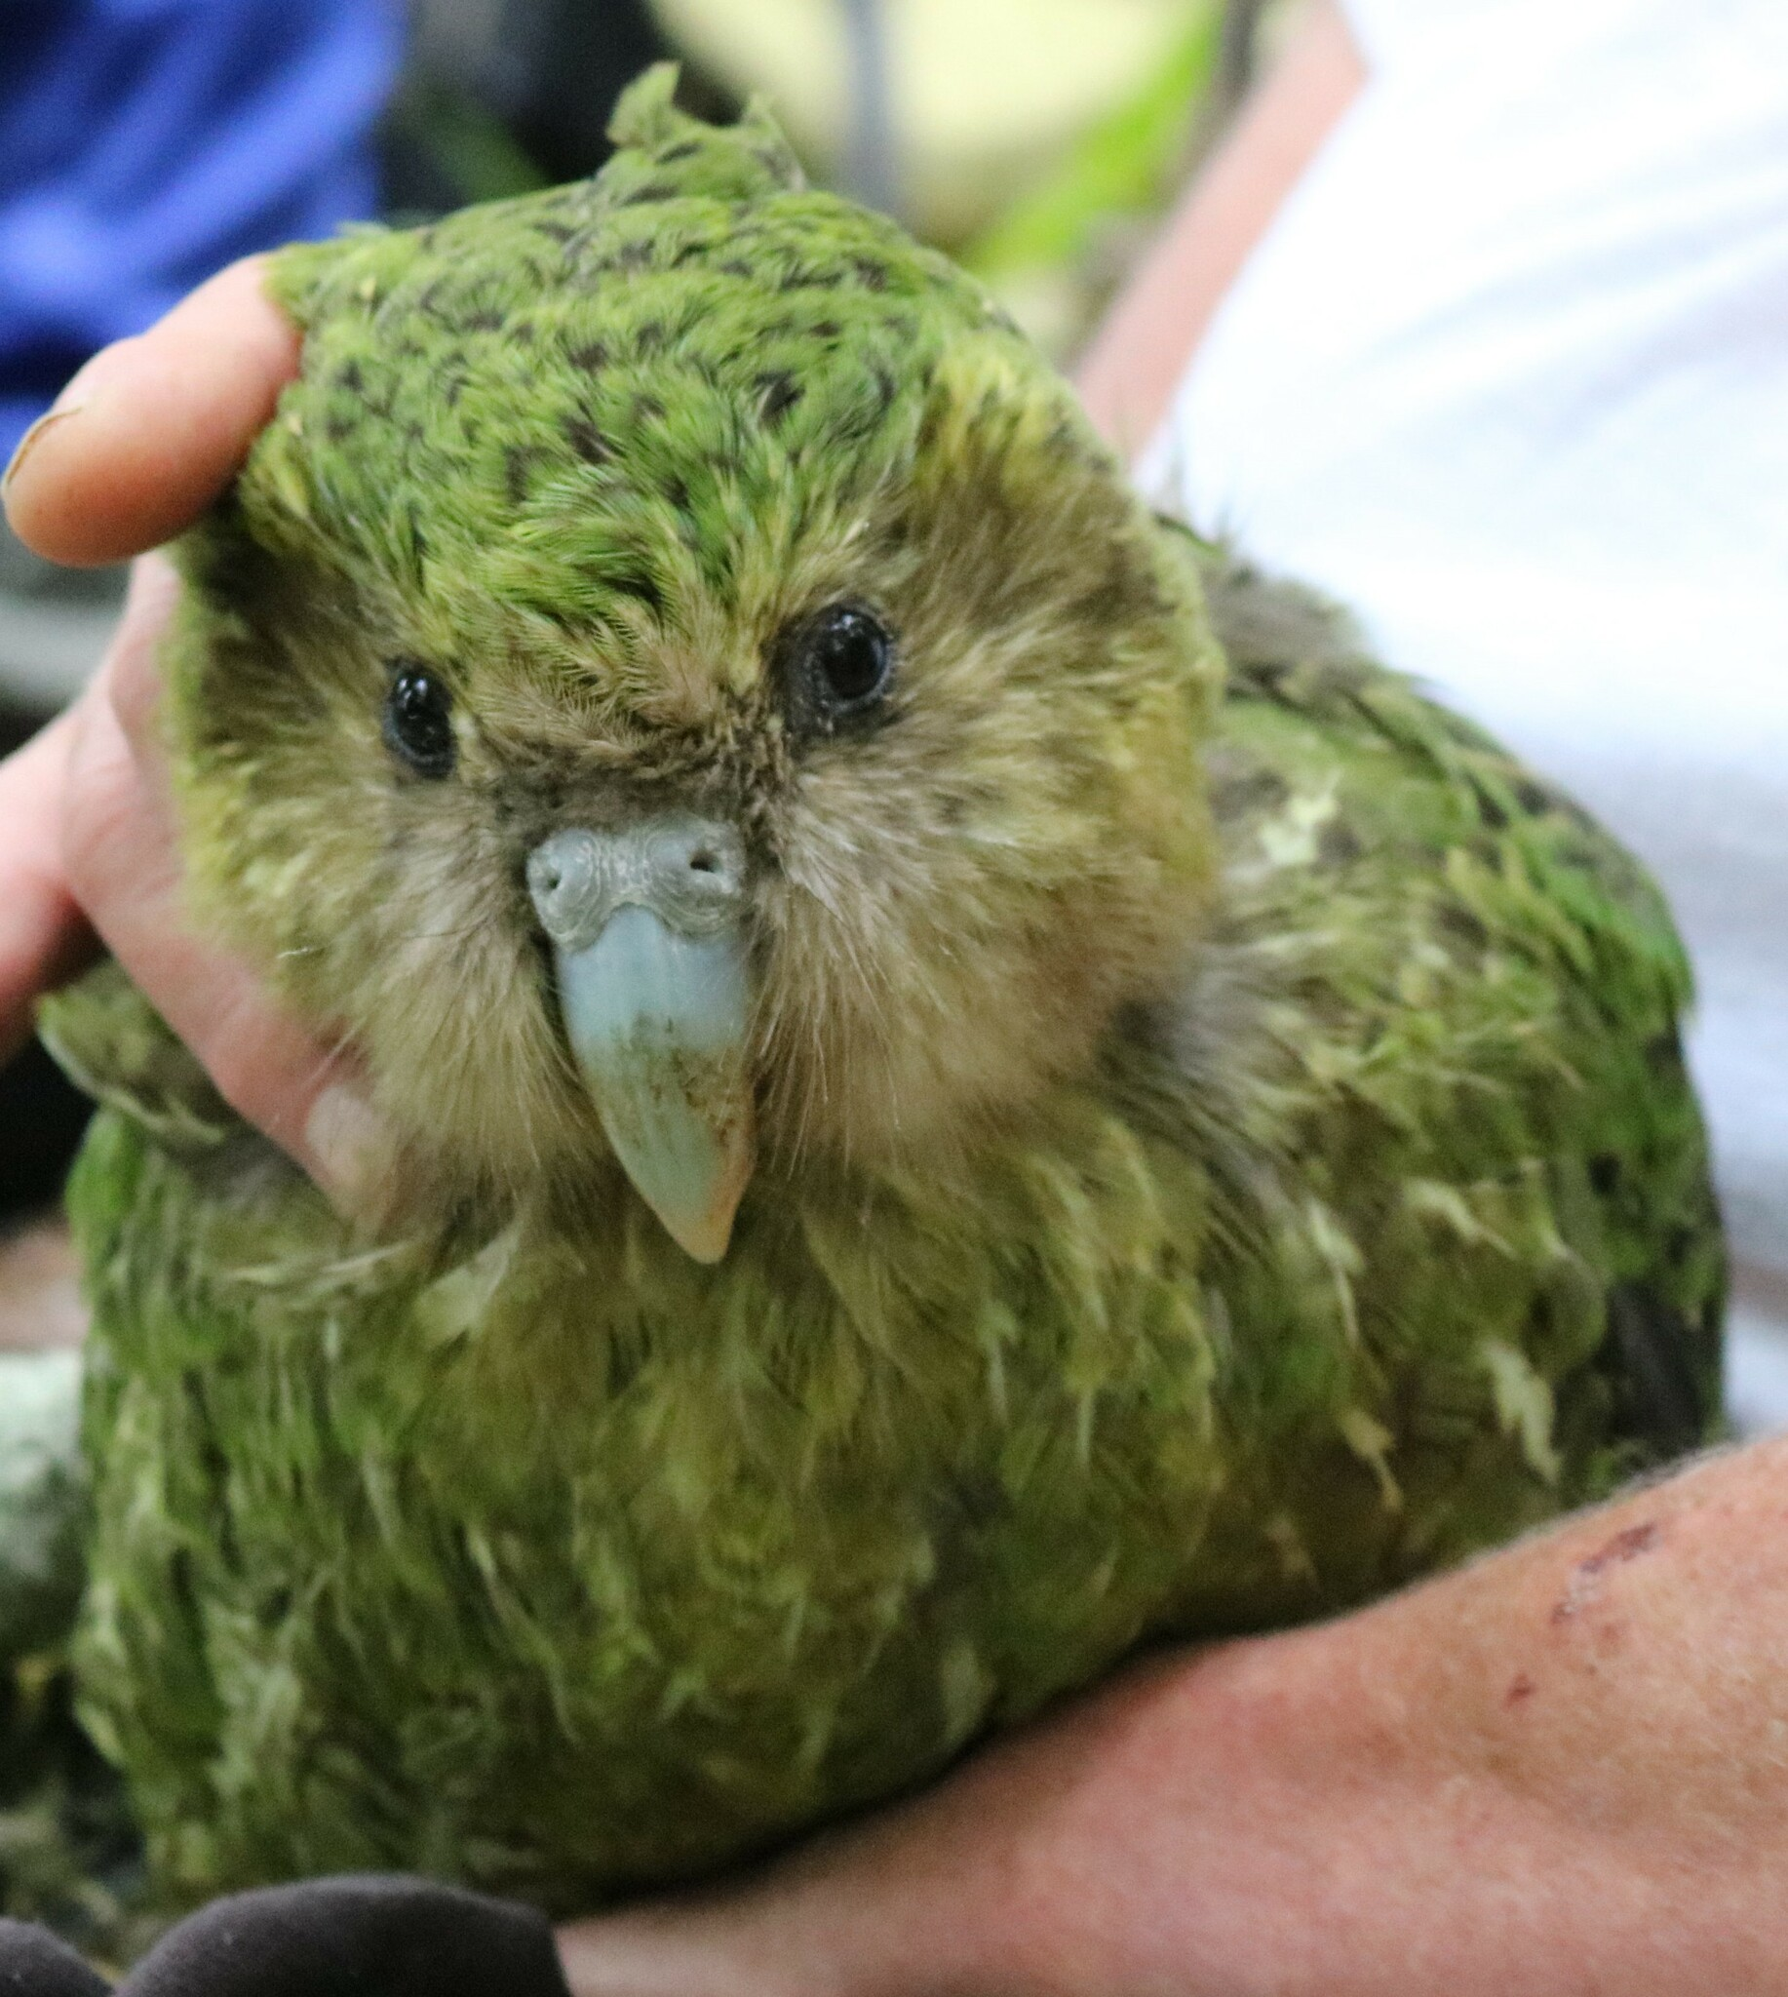
Article 30.1 Gender of genus-group names
If Latin, Latin.
If Greek, Greek.
If Greek but looks like Latin, like Latin.
If disclaimed, not Greek or Latin.
If “common or variable”, masculine.
If ends in -ops, masculine.
© Oscar Dove https://www.inaturalist.org/observations/232197898

Slide 17
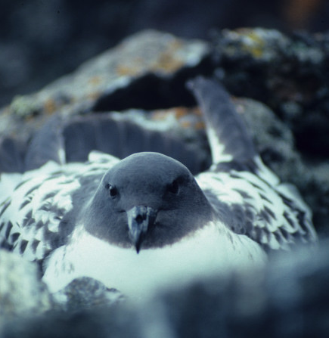
Article 30.2 Gender of genus-group names
If in “modern European language”,
the gender of that word.
Else, as noted by author.
Or by combination.
Or masculine,
unless ends in -a (feminine.);
-um, -on, or -u (neuter).
© Lucy Keith-Diagne https://www.inaturalist.org/observations/66545663

Slide 18
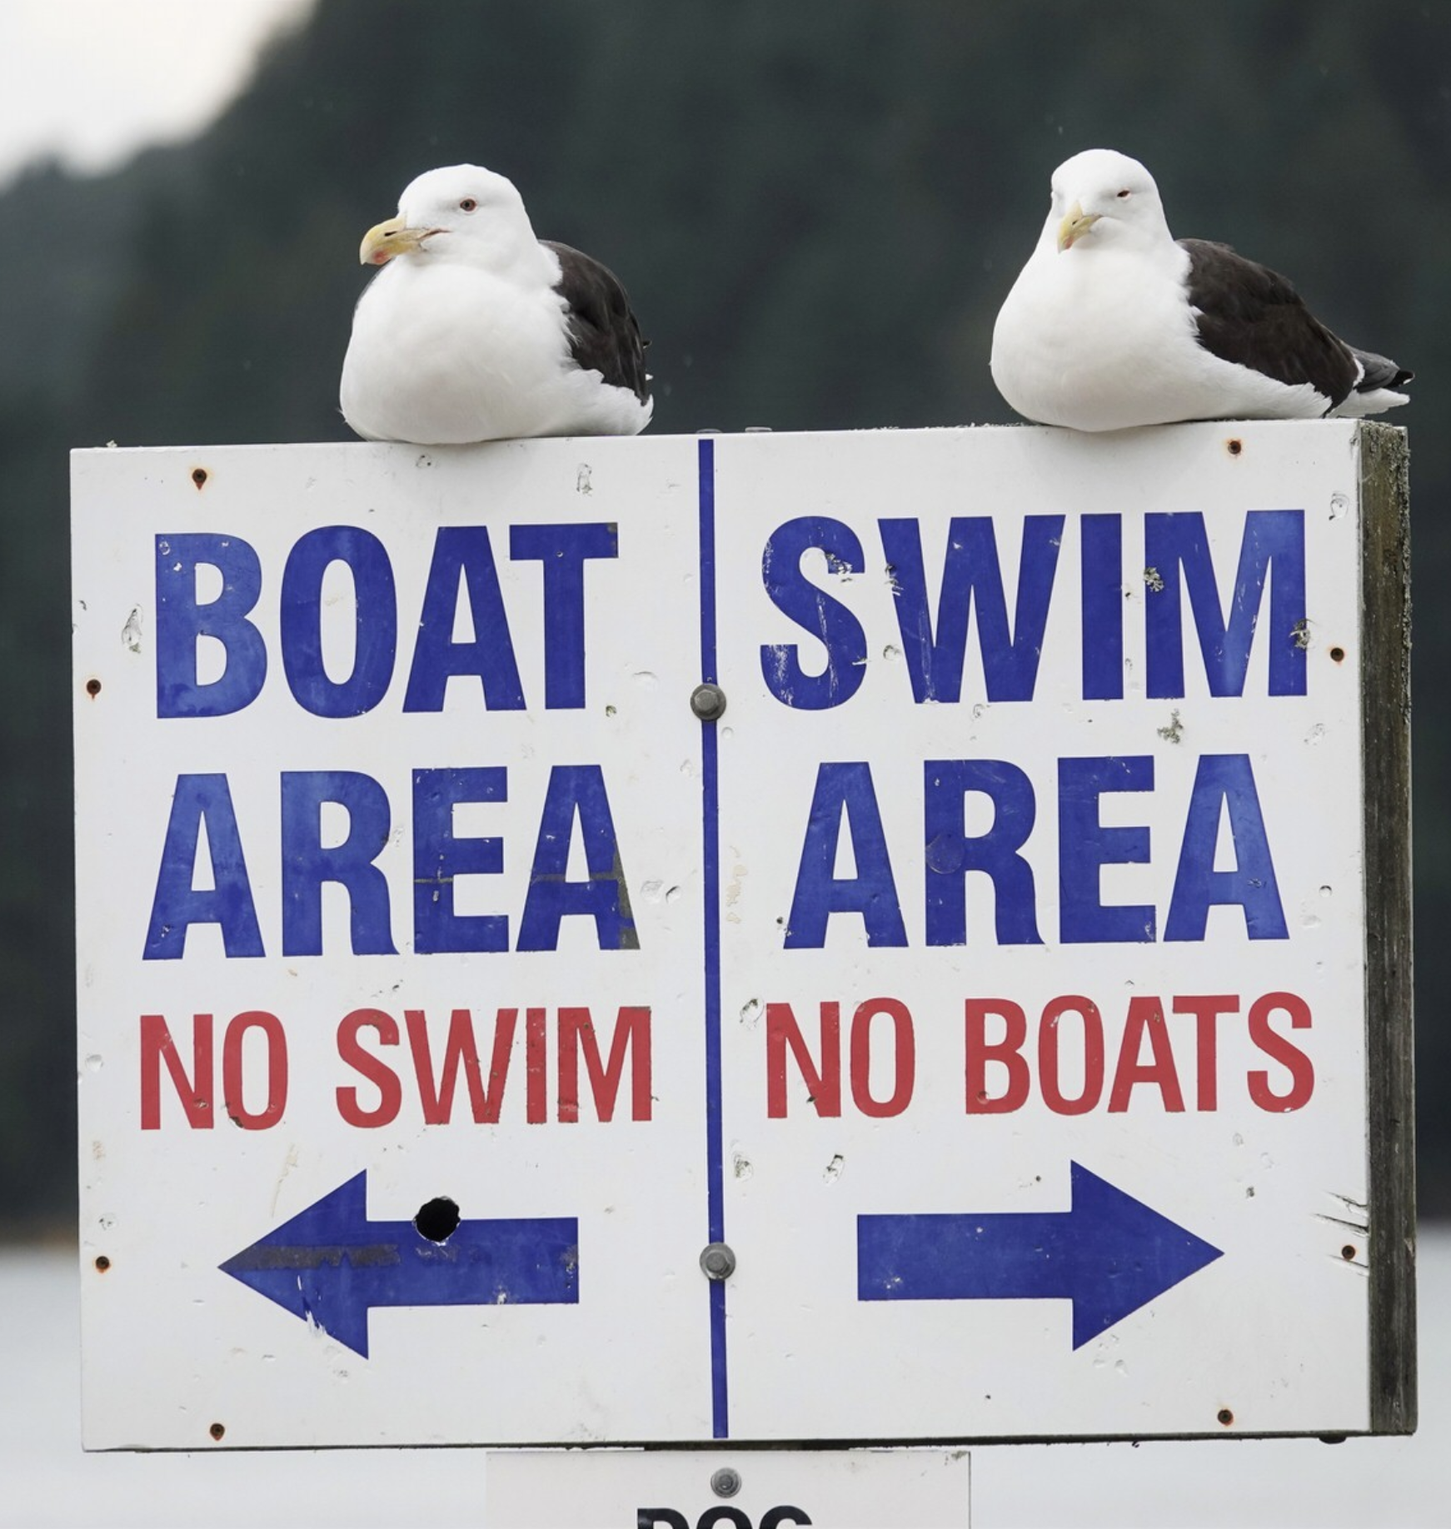
Article 31.2 Agreement
Species must agree with genus.
31.2.1: Compound names ≠ agree.
31.2.2: If either N or Adj:
Did the author note it?
Is usage decisive?
Can it be regarded as either?
© Jacqui Geux https://www.inaturalist.org/observations/21102814

Slide 19
Article 31.2 Agreement
But it really depends.
Compound nouns: 11 species.
Substantives: 11 species.
Unclear N+Adj: 10 species.
Medieval Latin: 6 species.
Errors in Code examples: 2.
Unresolvable: ???
© Jacqui Geux https://www.inaturalist.org/observations/21102814

Slide 20
Local birds with confusing names
Megalapteryx didinus, Euryapteryx curtus, Euryapteryx curtus curtus, Dendrocygna, Cygnus atratus, Cygnus sumnerensis chathamicus, Branta, Numida, Callipepla, Callipepla californica, Synoicus, Ptilinopus, Eudynamys, Aegotheles, Hirundapus, Hirundapus caudacutus, Hirundapus caudacutus caudacutus, Apus, Apus pacificus, Apus pacificus pacificus, Zapornia pusilla, Tribonyx hodgenorum, Haematopus, Pluvialis dominicus, Numenius hudsonicus, Arenaria, Calidris, Calidris acuminata, Calidris ferruginea, Calidris alpina, Calidris melanotos, Calidris pusilla, Phalaropus, Phalaropus fulicarius, Phalaropus lobatus, Anous albivittus, Gygis alba, Larus dominicanus dominicanus antipodum, Onychoprion fuscatus serratus, Onychoprion anaethetus melanopterus, Chlidonias leucopterus, Chlidonias hybridus, Chlidonias hybridus javanicus, Aptenodytes patagonicus, Pygoscelis papua taeniata, Diomedea, Diomedea antipodensis, Diomedea antipodensis antipodensis, Thalassarche, Thalassarche impavida, Hydrobates leucorhous, Thalassoica, Daption capense, Ardenna pacifica chlororhyncha, Pelecanoides georgicus, Pelecanoides georgicus georgicus, Morus, Sula leucogaster plotus, Bubulcus ibis coromandus, Ardea intermedia plumifera, Botaurus poiciloptilus, Aquila, Tyto alba delicatula, Athene, Eurystomus orientalis pacificus, Todiramphus, Todiramphus sanctus, Cacatua galerita, Platycercus eximius, Cyanoramphus, Cyanoramphus novaezelandiae chathamensis, Anthornis, Anthornis melanura obscura, Anthochaera carunculata, Gerygone, Gerygone albofrontata, Mohoua, Artamus cyanopterus, Gymnorhina, Petroica, Petroica macrocephala, Petroica macrocephala macrocephala, Poodytes punctatus stewartianus, Passer domesticus, Acanthis, Acanthis flammea, Anas, Oreortyx, Coturnix coromandelica, Lophura nycthemera, Lagopus, Lagopus lagopus scotica, Pluvialis apricaria, Passer montanus, Alectoris rufa
© Jacqui Geux https://www.inaturalist.org/observations/21102814

Slide 21
Ok, so the Code is bad. So what?
The problem isn't just ambiguity in the Code.
It's how that Code is applied.
© Jacqui Geux https://www.inaturalist.org/observations/21102814

Slide 22
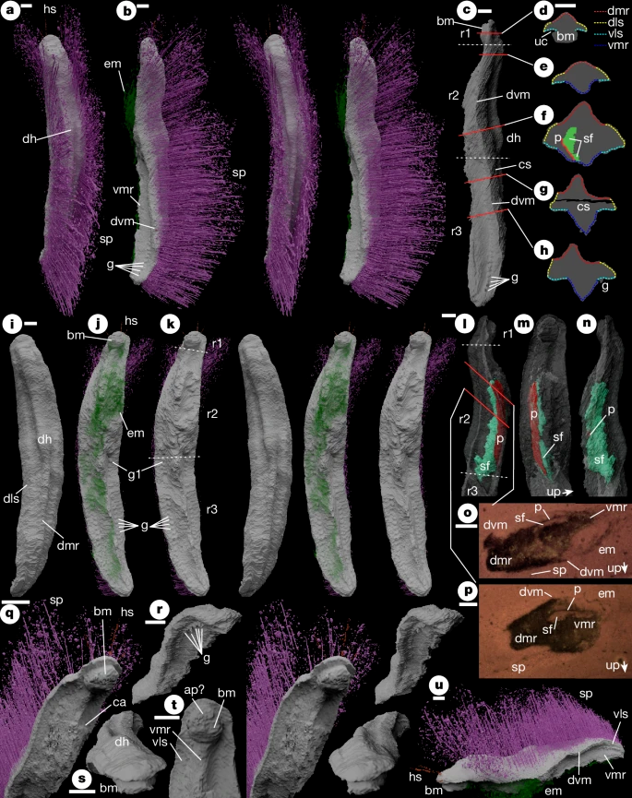
The problem with names
Eponyms
Rhynchophanes mccownii, Pterodroma cookii
Misspellings in original definitions
Chelaner burchera, A. lopdelli
Names with no historical basis
Athene, Calidris canutus
Confusing names
Calidris melanotos
Silly names.
Daption capense
Punk and Emo
CC By Mark D. Sutton, Julia D. Sigwart, Derek E. G. Briggs, Pierre Gueriau, Andrew King, David J. Siveter & Derek J. Siveter - https://www.nature.com/articles/s41586-024-08312-0

Slide 23
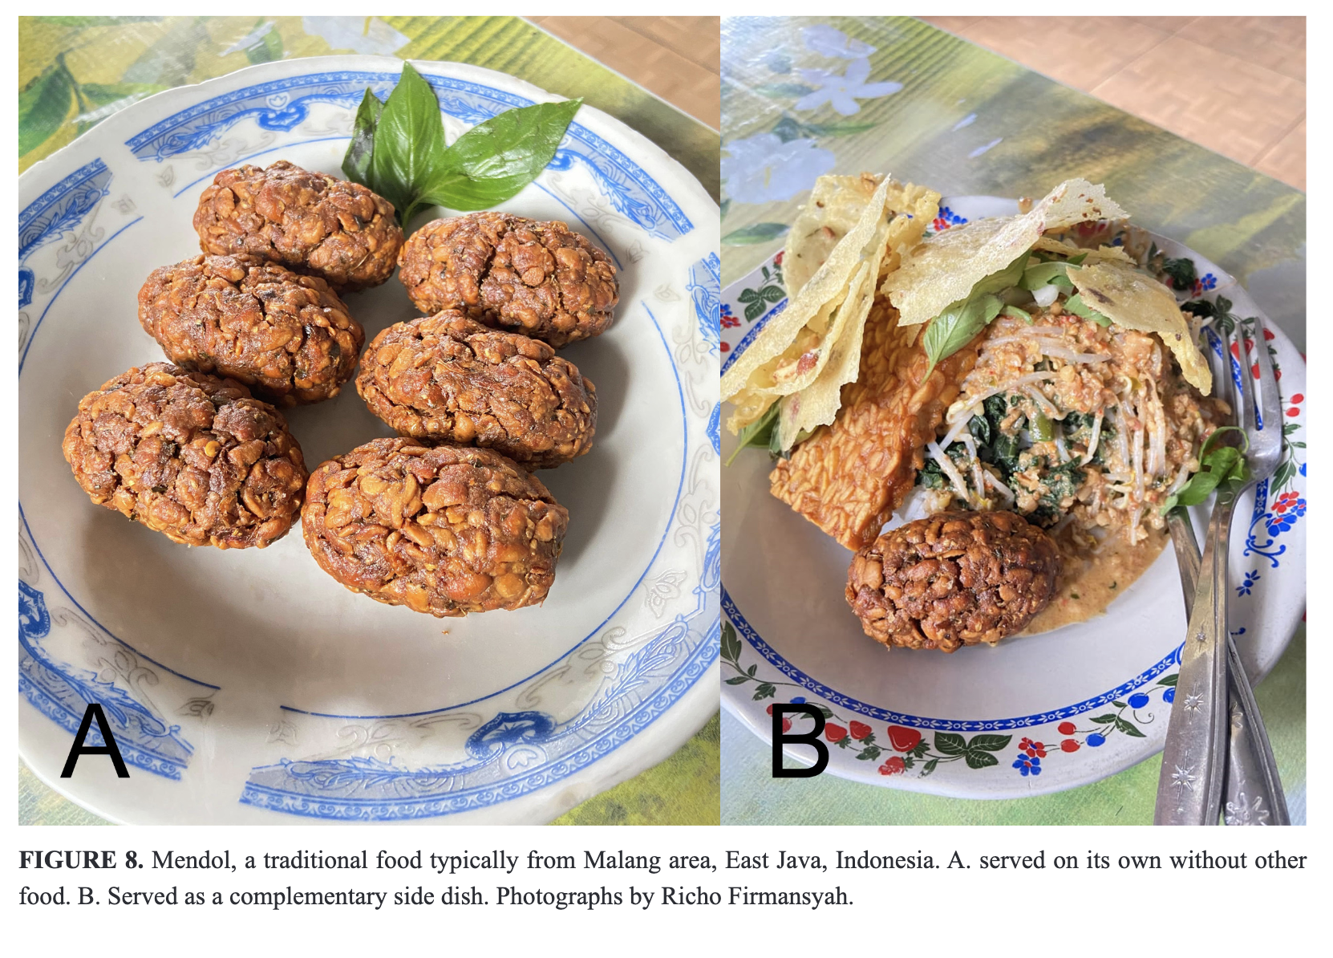
Awal Riyanto Orcid, Muhammad A. Fauzi Orcid, Ahmad M. Kadafi Orcid, Misbahul Munir, Amir Hamidy Orcid, Irvan Sidik Orcid, Richo Firmansyah Orcid, Retno Lestari Orcid, Fadhillah Orcid, Abinawanto Orcid, & N. Smith. 2025. One more new bent-toed gecko of the Javanese Cyrtodactylus marmoratus complex (Squamata: Gekkonidae) from East Java, Indonesia. Zootaxa Vol. 5683 No. 2: 20 Aug. 2025. https://doi.org/10.11646/zootaxa.5683.2.2. CC-BY-NC

Slide 24
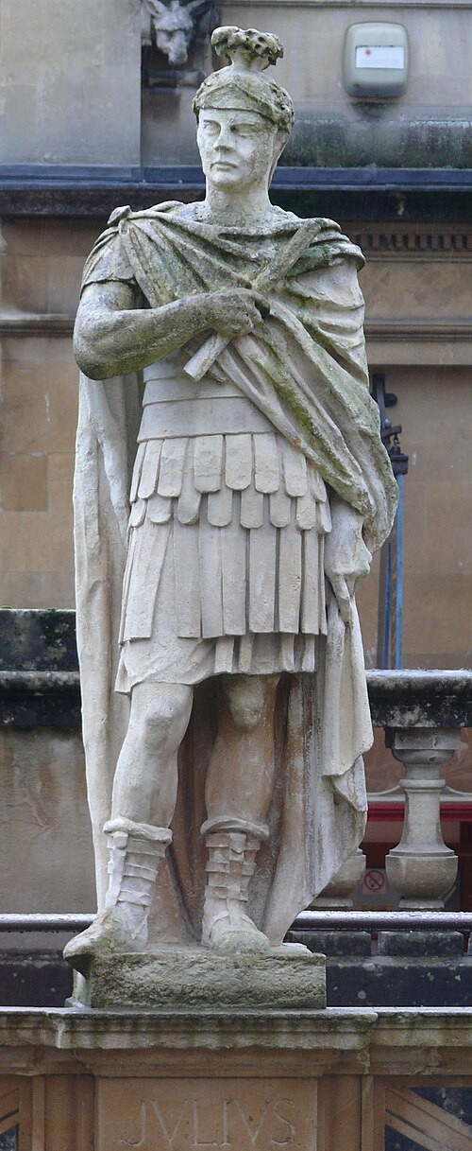
Gender agreement
What's a dictionary?
Generally, masculine and feminine are marked - and neuter is unmarked. Neuter is the default.
Names ending in -a aren't all feminine.
Substantives
© Jacqui Geux https://www.inaturalist.org/observations/21102814
CC-BY-SA Ad Meskens Wikipedia

Slide 25
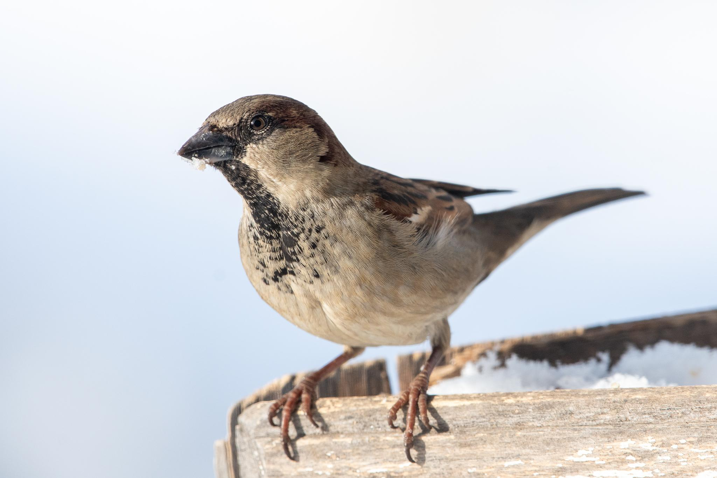
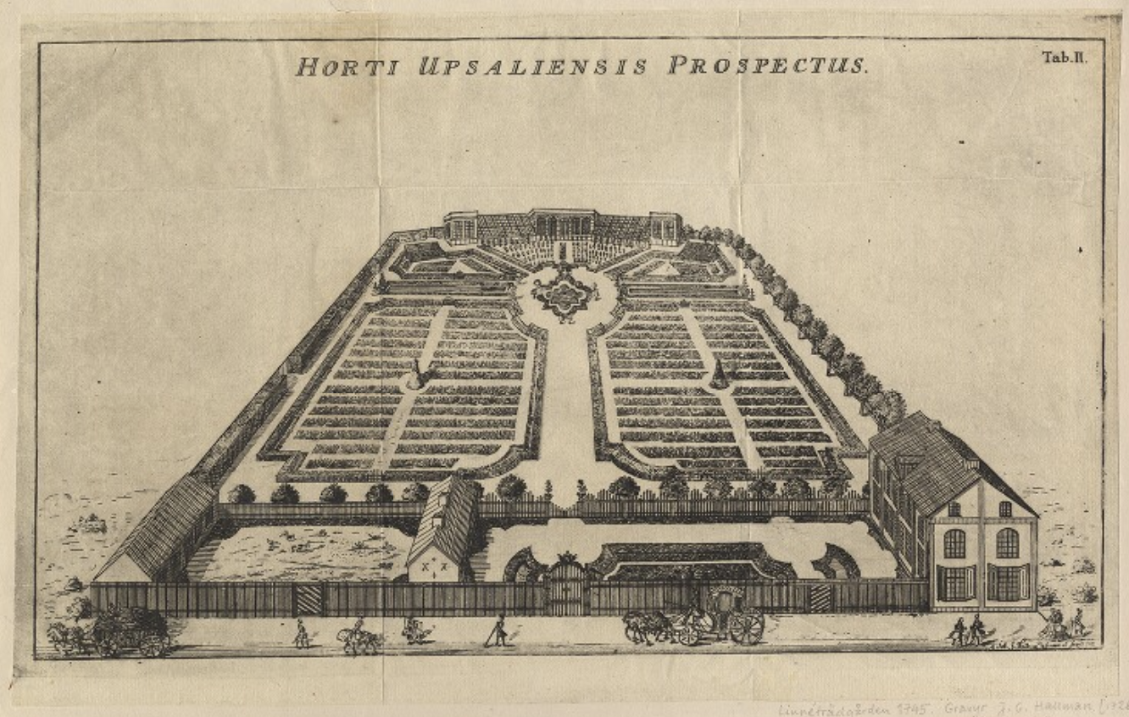
Passer domestica
In Medieval Latin means "housemaid"
Probably not the intended meaning.
But Linnaeus had 81 housemaids at his home in Uppsala (Pónten 2020)
According to Art. 31.2, could be the meaning, so should be.
But it isn't.
© Jacqui Geux https://www.inaturalist.org/observations/21102814
Public Domain

Slide 26
Ok, again, so what?
The Code exists to standardize naming.
The methods are not impartial, clear, or reproducible.
The result is confusion and politics.
This sidelines voices:
Non-Anglo or Francophones
Indigenous
Women
Trans and takatāpui.
© Jacqui Geux https://www.inaturalist.org/observations/21102814
Public Domain

Slide 27
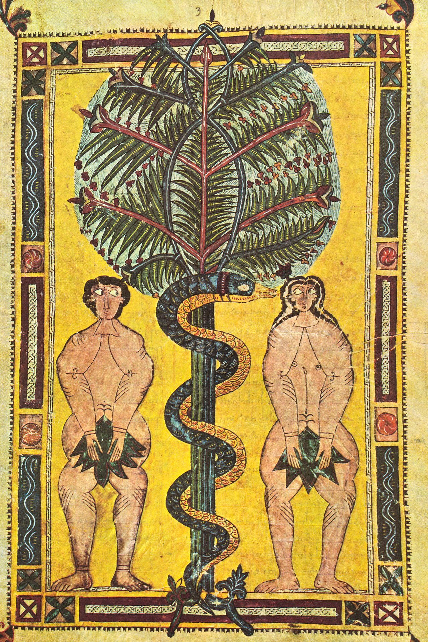
Thanks.
Questions?
http://richard.social
Adam and Eve Expulsion c. 950, Public Domain
© Jacqui Geux https://www.inaturalist.org/observations/21102814
Public Domain

